Slide 1
Organizational Updates

Slide 2
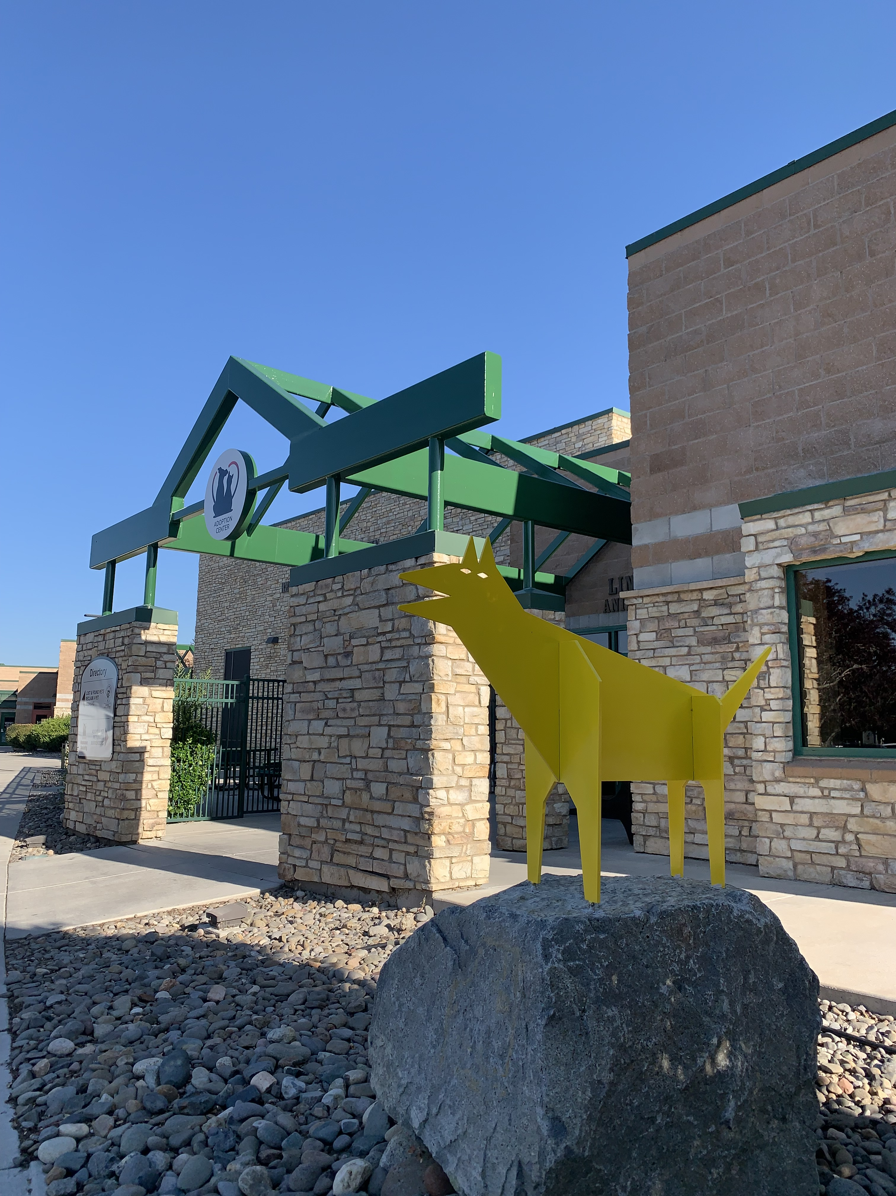
Organizational Updates
Prepared for Animal Services Advisory Board
May 16, 2025

Slide 3
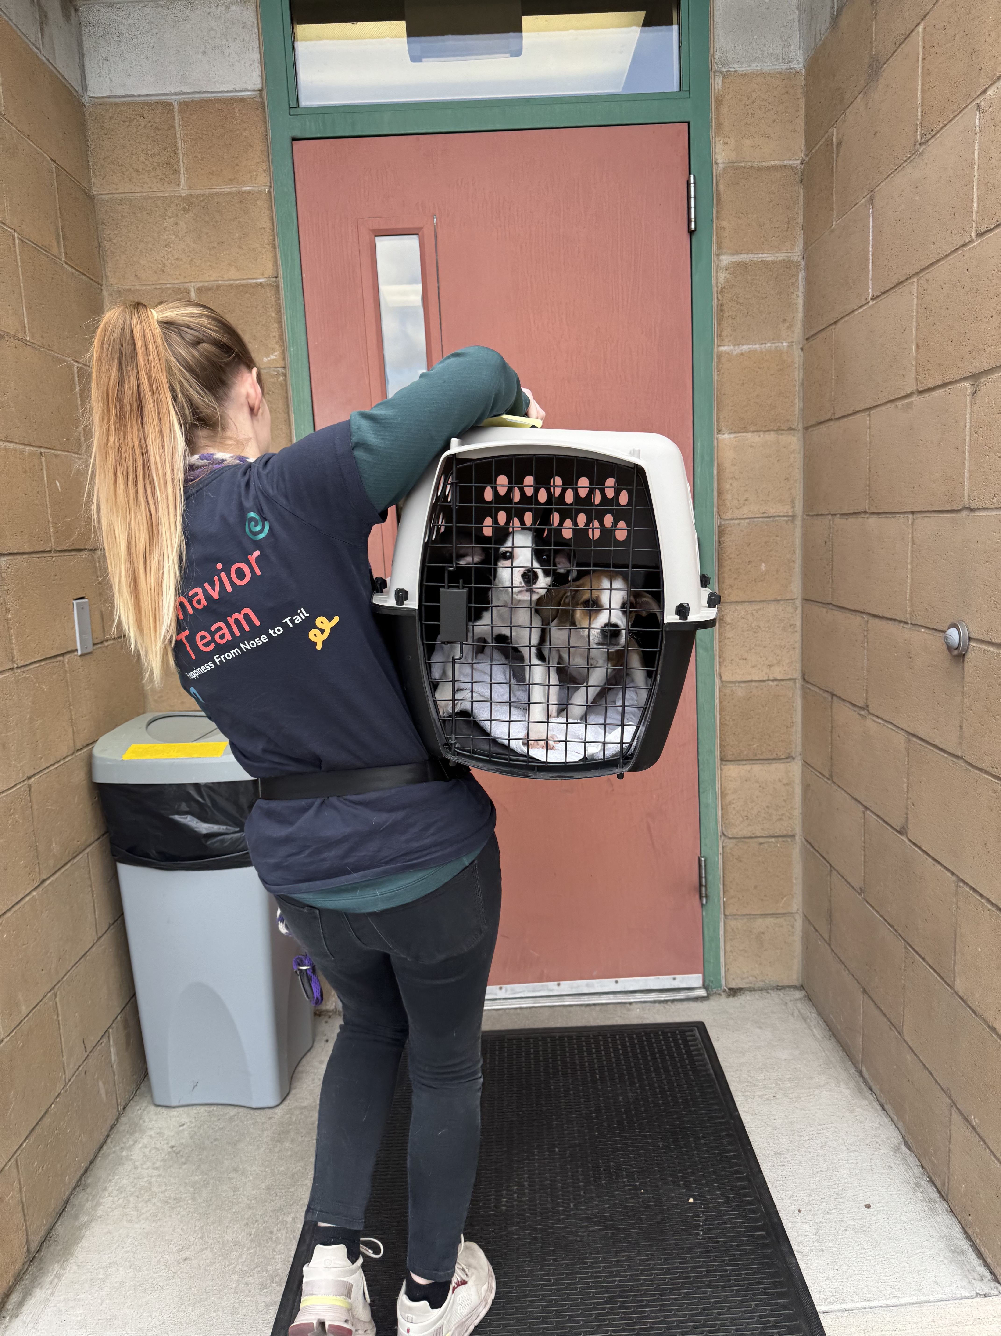
Community Intakes
Reno Campus
3,114
686
2024 - Year
Direct Community Intakes
2025 – Q1
Direct Community Intakes
4,275
719
2024 – Year
Transfers from WCRAS
2025 – Q1
Transfers from WCRAS

Slide 4
WCRAS Transfers

Slide 5
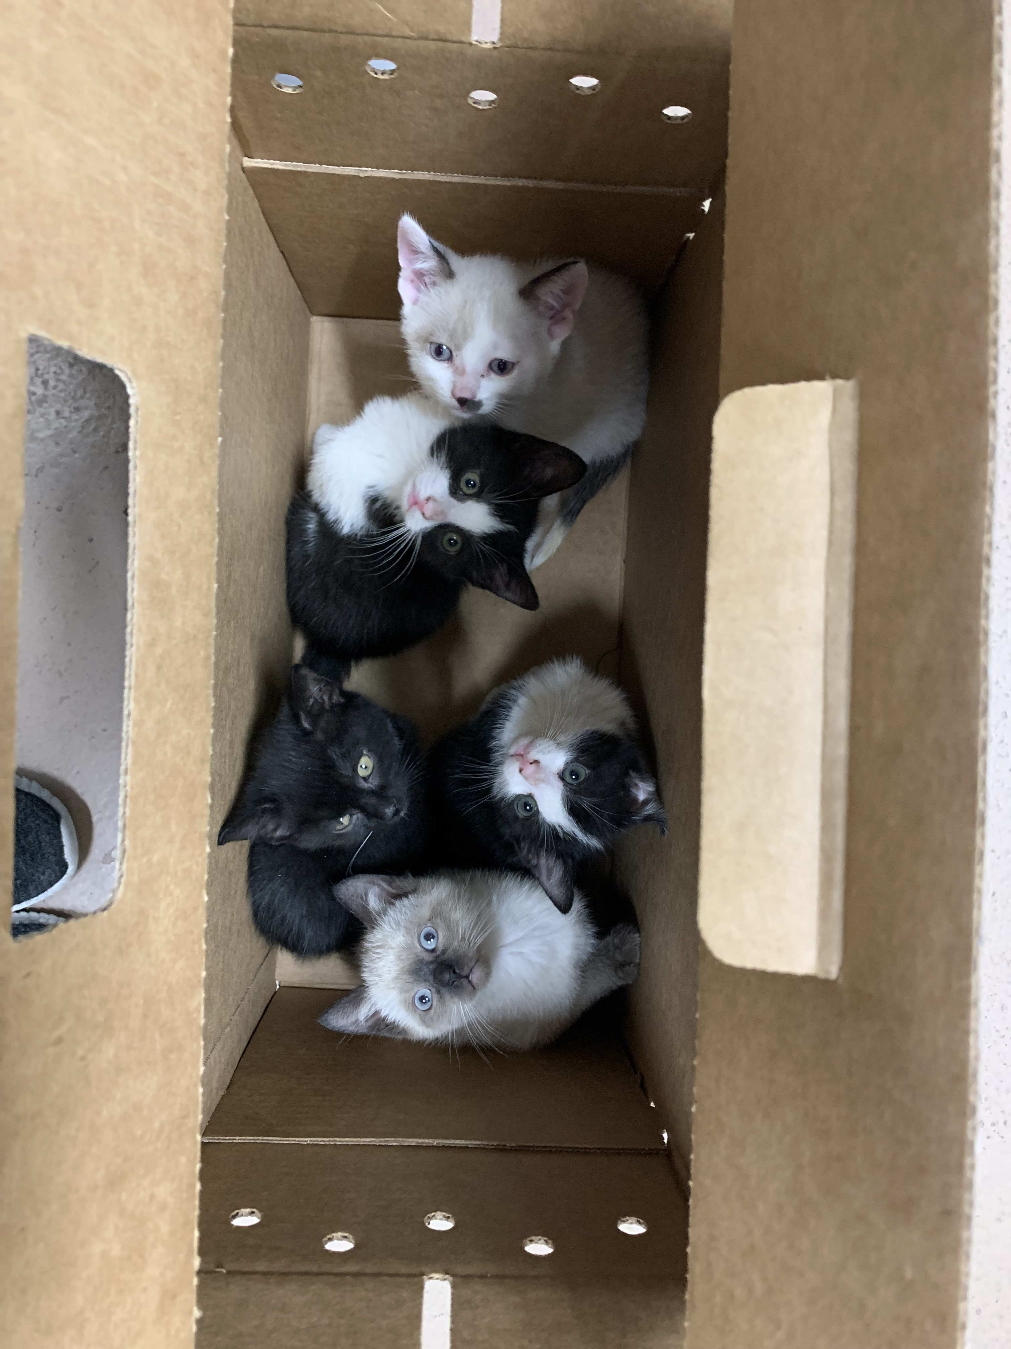
Community Intakes
Reno Campus – Good Samaritan Strays
63
45
2024 – Q1
Good Samaritan Strays
2025 – Q1
Good Samaritan Strays
1,099
45
2024 – Year
Good Samaritan Strays
2025 – YTD
Good Samaritan Strays

Slide 6
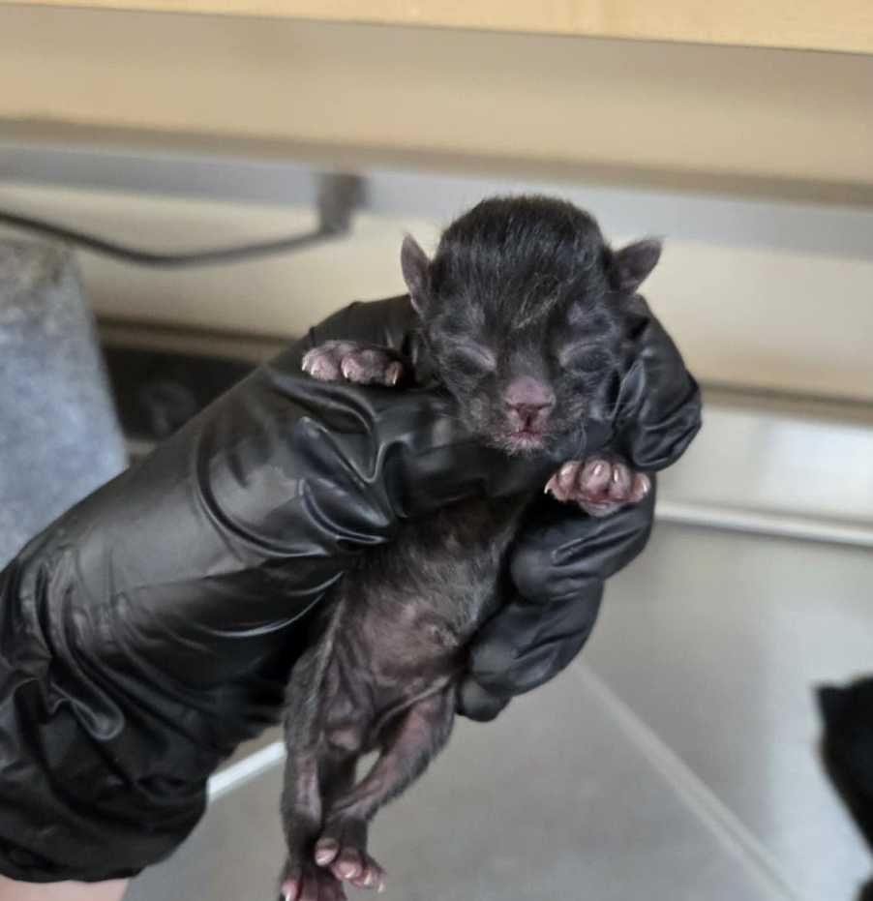
Day 1 with NHS
4 newborn kittens presented to clinic as a Good Samaritan Stray
All 4 were wrapped in their umbilical cords
Medical team worked to untangle them
Unfortunately, only Nightshade made it

Slide 7
Reno Intakes - Cats

Slide 8
Reno Intakes - Dogs

Slide 9
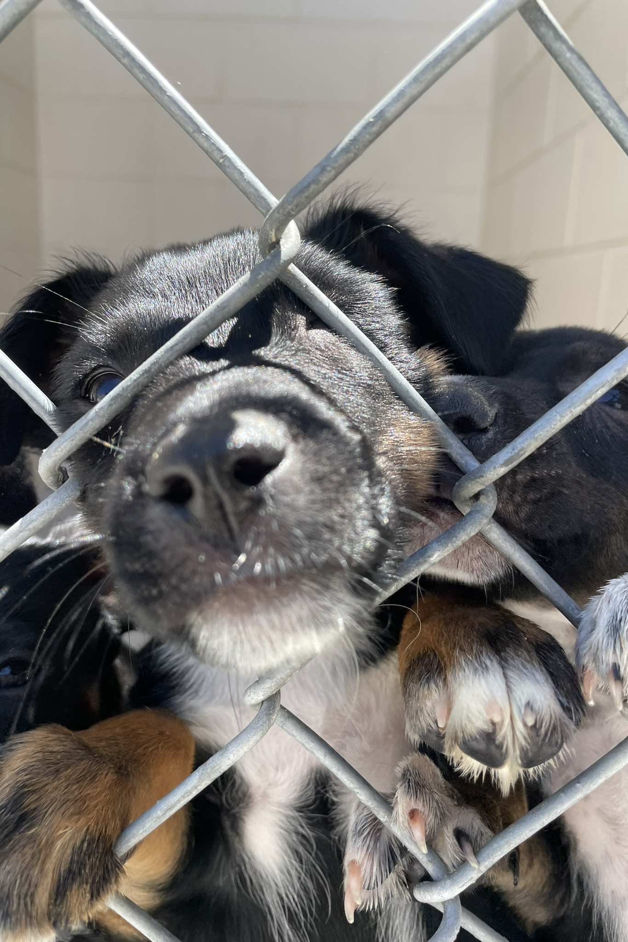
Length of Stay
Reno Campus – Cats / Dogs
18.3 / 19.6
12.6 / 14.7
2024 – Q1
Average (Cats / Dogs)
2025 – Q1
Average (Cats / Dogs)
79% / 74%
77% / 76%
2024 – Q1
% Outcomes in 0 to 14 days
2025 – Q1
% Outcomes in 0 to 14 days

Slide 10
Length of Stay - Cats

Slide 11
Length of Stay - Dogs

Slide 12
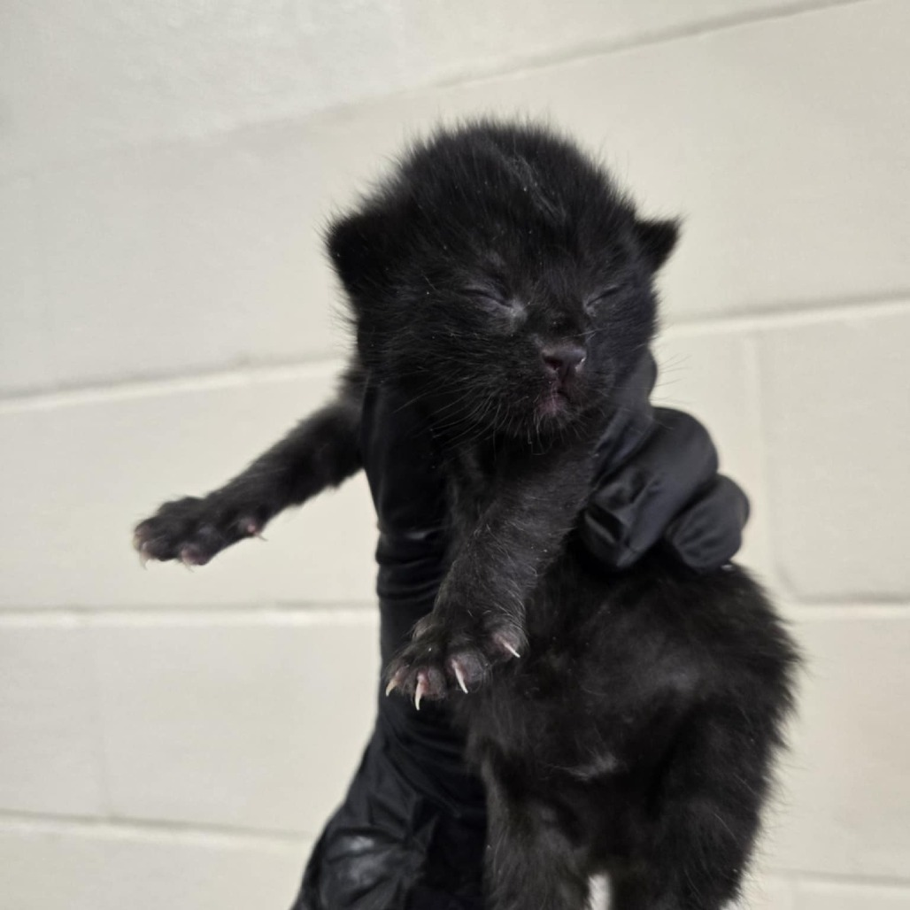
Day 9 with NHS
10 pm on Thursday, one of our VAs gets a call on the After-Hours Emergency Phone
Nightshade has been on-and-off the bottle for the past few days and is now lethargic
Our VAs triage the call and makes an emergency drop off appointment for the morning
DVM exam & diagnostics reveal constipation. Treatments are given.

Slide 13
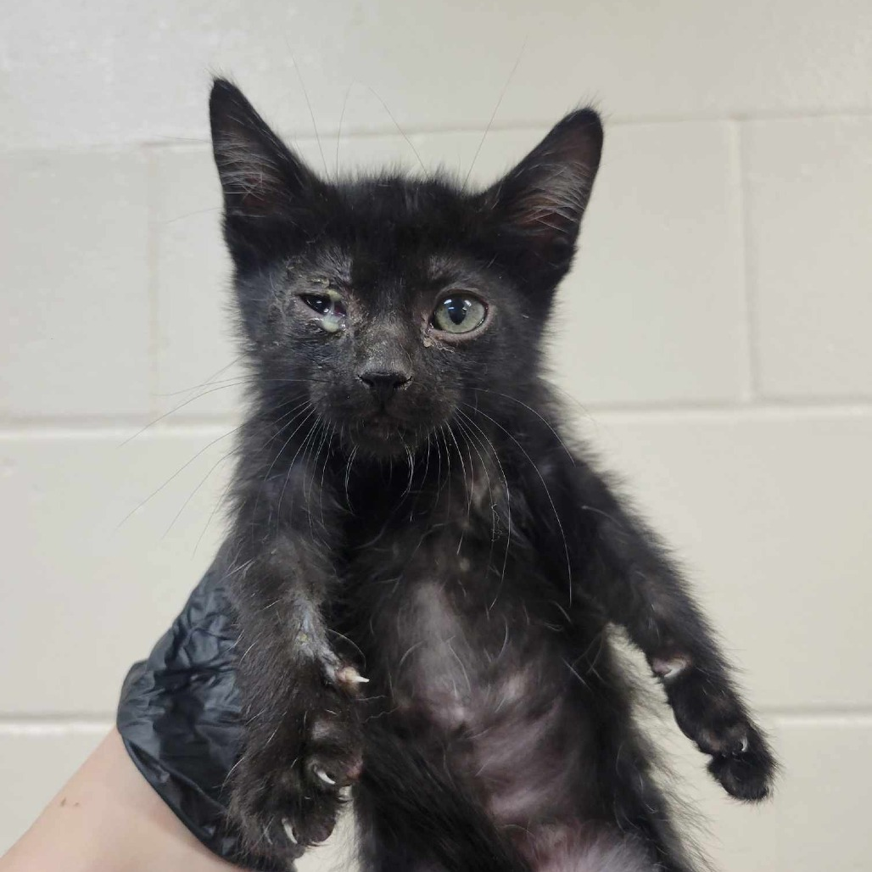
Day 43 with NHS
The CSR team receives an email from foster parent for "goopy eyes"
Drop-off appointment made for the following day
Day of appointment, foster states the kitten started having diarrhea last night
Treatments given and medications prescribed

Slide 14
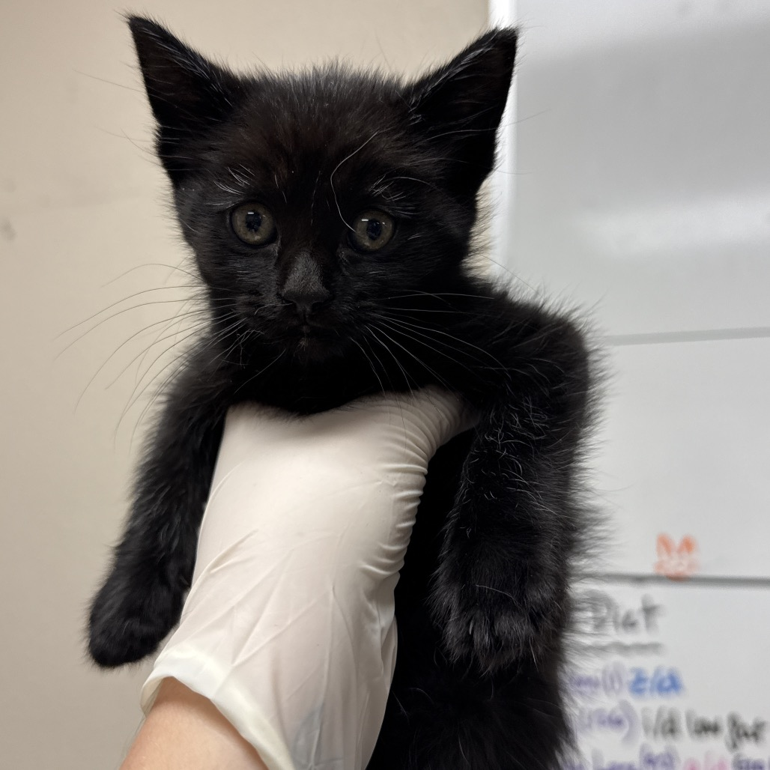
Day 47 with NHS
Foster dropping off for neuter!
  CSR checks kitten in
  Medicine Team Wood’s Lamps and confirms sex
  Surgery Team works him into their flow for the day
  Cat Team transports to recovery kennel for the night

Slide 15
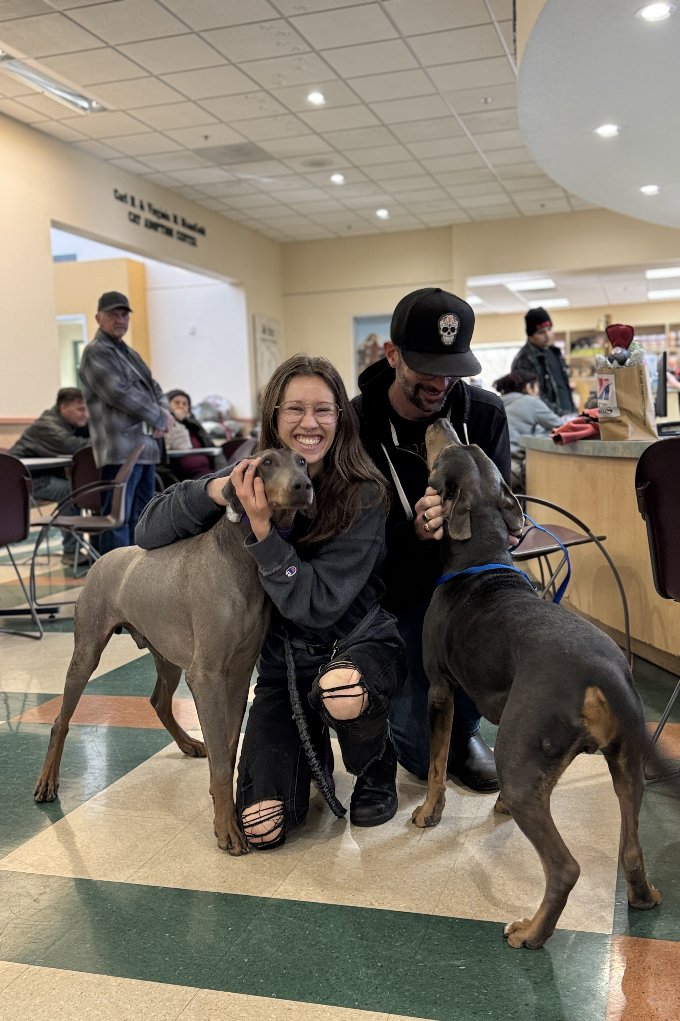
Adoptions
Reno Campus
638
708
2024 – Q1
Cats
2025 – Q1
Cats
693
745
2024 – Q1
Dogs
2025 – Q1
Dogs

Slide 16
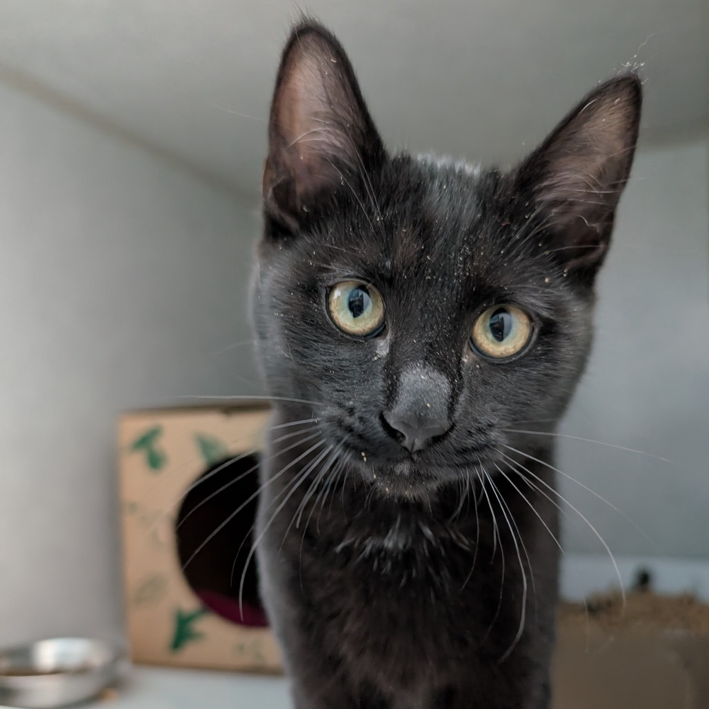
Day 55 post NHS
At time of adoption scheduled an appointment for our public vaccine clinic
Came in on a Wednesday for our vaccine clinic to get his FVRCP and Rabies vaccines
Adopter says Nightshade has adapted very well into the home and sleeps with her daughter every night

Slide 17
Outcomes - Cats

Slide 18
Outcomes - Dogs

Slide 19
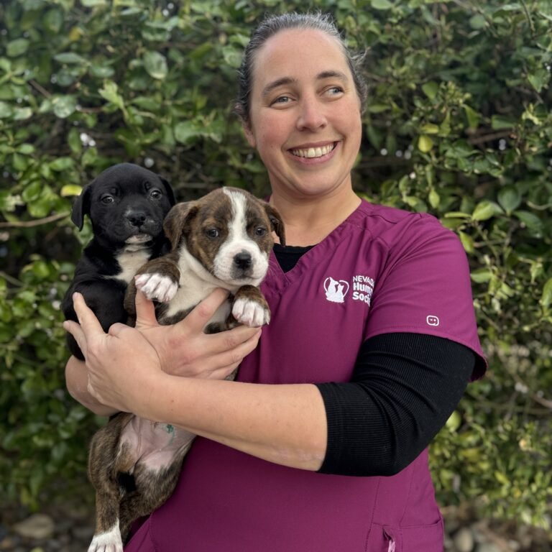
Dr. Fitzpatrick
Director of Community Medicine & Surgery

Slide 20
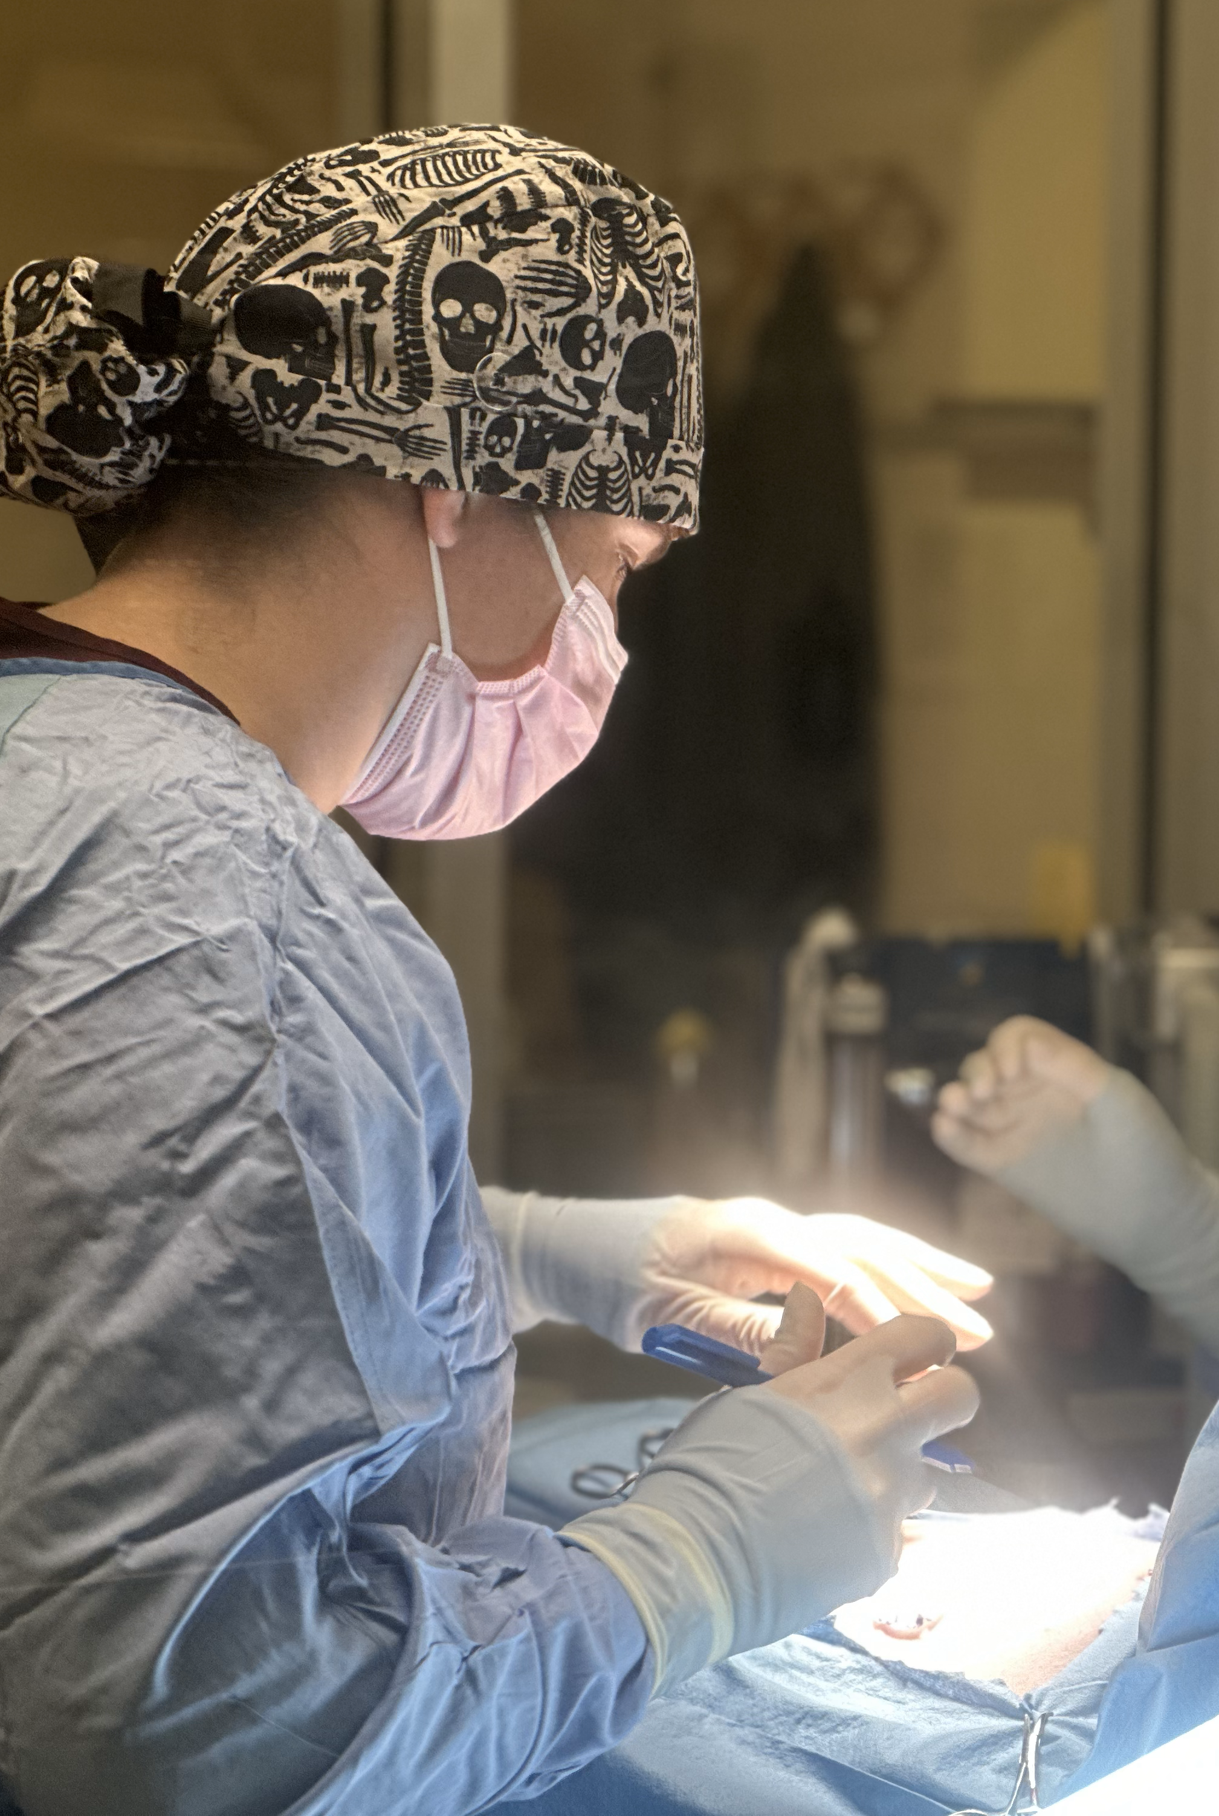
Public Clinic
Reno Campus
454
866 / 443
2025 – Q1
Cats – S/N
2025 – Q1
Cats – Vaccines / Microchips
17
1,497 / 87
2025 – Q1
Dogs – S/N
2025 – Q1
Dogs – Vaccines / Microchips

Slide 21
Reno Public Clinic

Slide 22

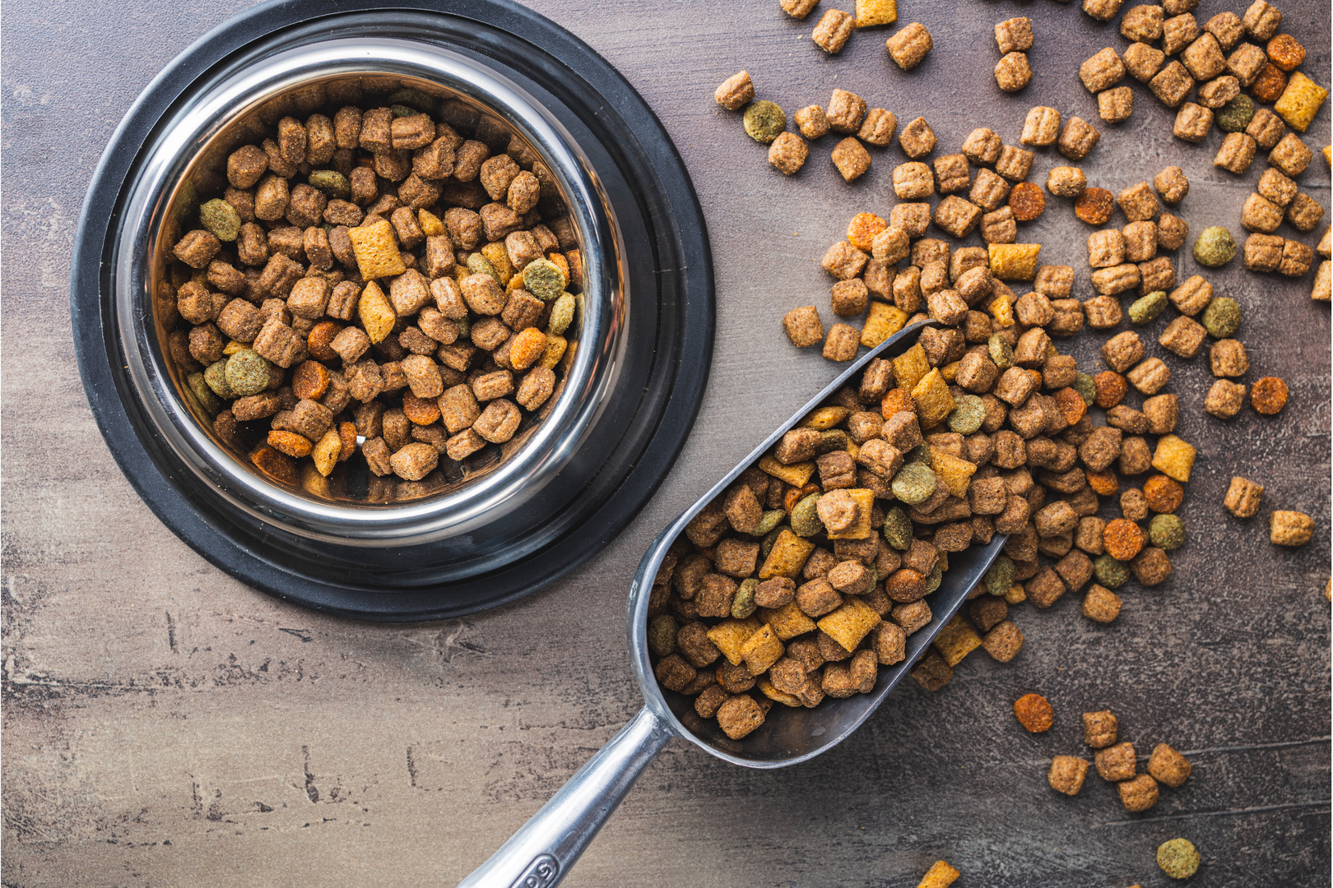

Community Programs
Our focus with Community Programs is to effectively deliver the low-cost services and resources to the populations in our communities most in need.
  Pet Pantry
    Provided 48,460 lbs of dry food and 3,270 cans of wet food in the first quarter of 2025, helping 5,471 owned animals and colony cats
  Community Medicine & Surgery
    Expanded surgery and vaccine options
  Community Support Events
    Participating in events like Pets of the Homeless Wellness Clinic, where NHS will be providing free microchips and 50 free S/N vouchers

Slide 23
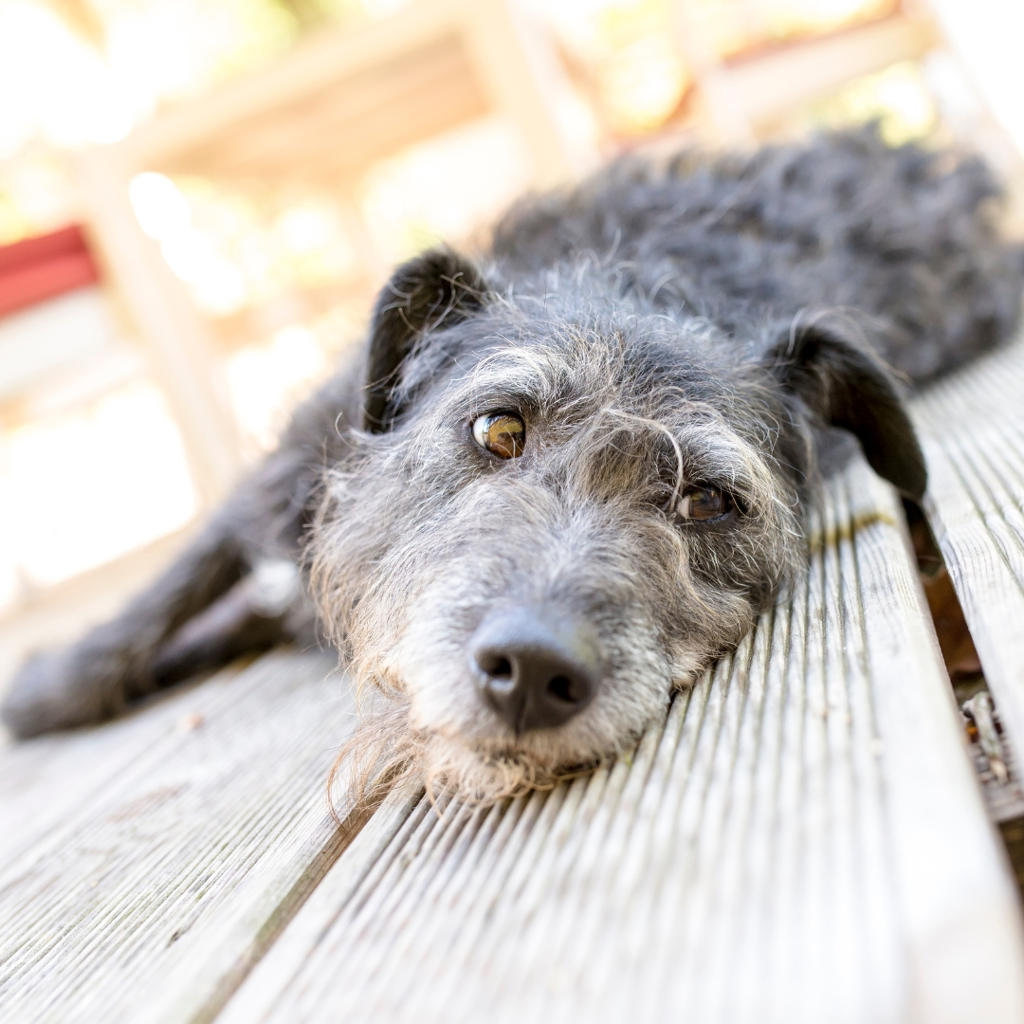

Pets of the Homeless
Carson City Wellness Clinic on October 19th, 2024
NHS serviced 99 animals
66 free microchips provided by NHS and 24Petwatch
65 free Licenses issued by NHS
Reno Wellness Clinic occurring May 17th, 2025
Expecting up to 200 pets in need of services
NHS will be providing free microchips
NHS will be offering $10,000 worth of free S/N services

Slide 24


